Slide 1
Percentage Increase and Decrease
Aim – Be able to:
Calculate the multiplier
Calculate a percentage increase or decrease of an amount
Understand profit and loss
PBS Focus: keeping the volume appropriate.
Plan:
Convert FDP
Percentage increase and decrease
Profit loss questions
worksheet

Slide 2
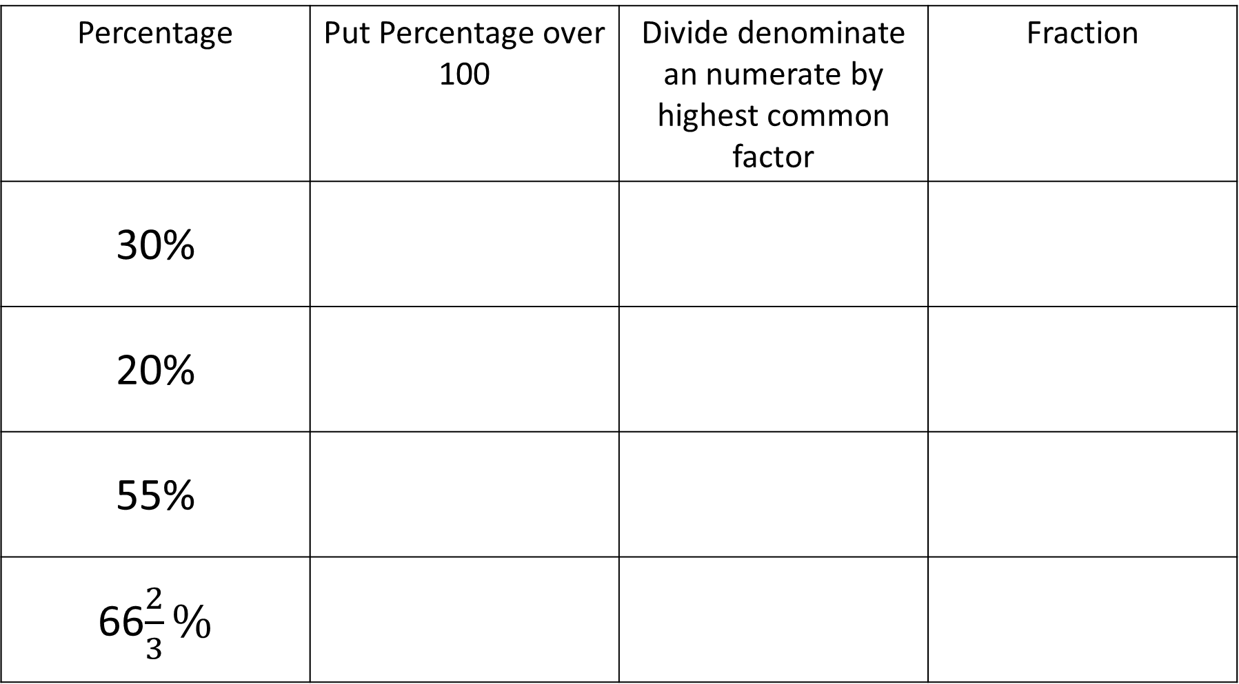
Converting percentages to fractions:
Percentage | Put Percentage over 100 | Divide denominate an numerate by highest common factor | Fraction
30%
20%
55%
66$\frac{2}{3}\%$

Slide 3
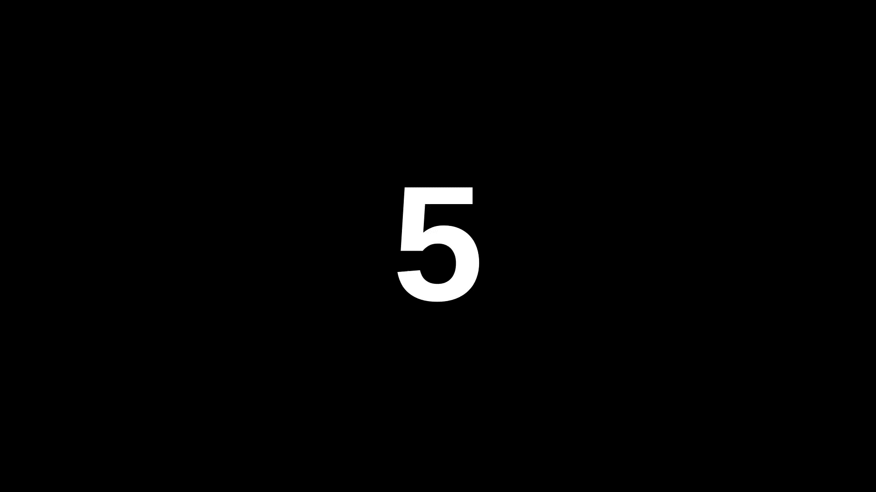
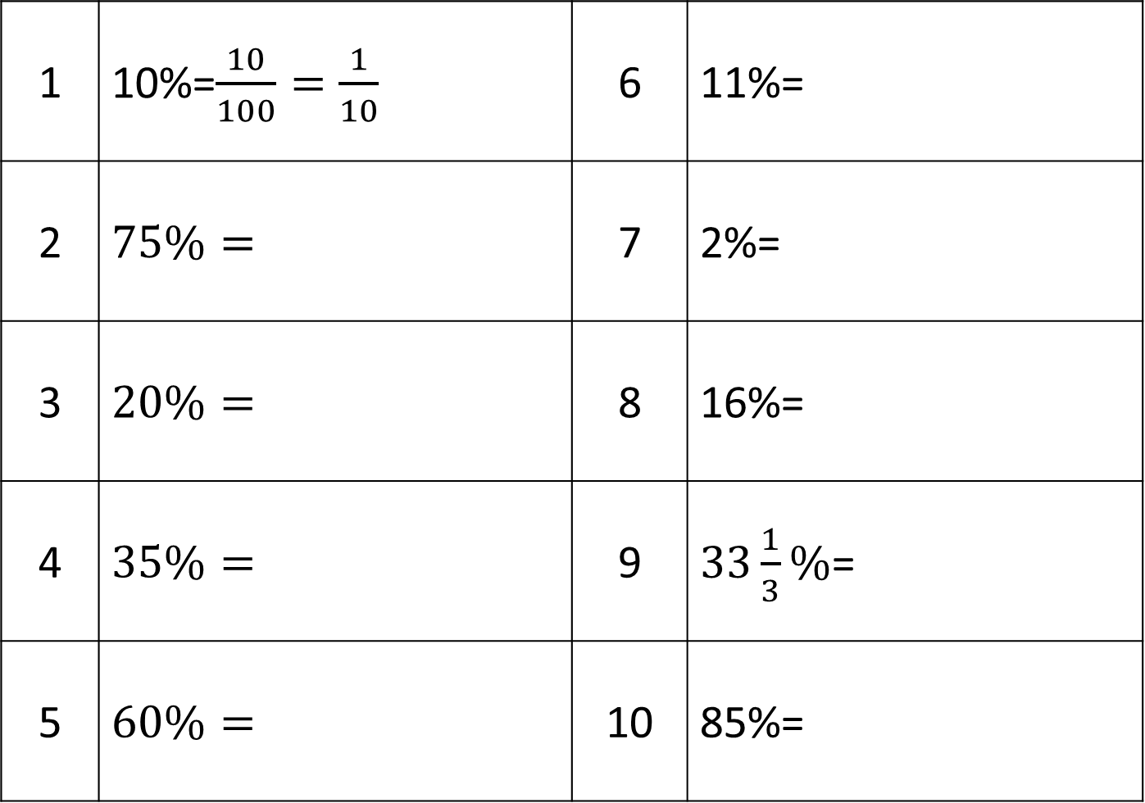
1 | 10%=$\frac{10}{100}=\frac{1}{10}$ | 6 | 11%=
2 | $$75\%=$$ | 7 | 2%=
3 | $$20\%=$$ | 8 | 16%=
4 | $$35\%=$$ | 9 | $33\frac{1}{3}\%$=
5 | $$60\%=$$ | 10 | 85%=
Convert to fractions

Slide 4
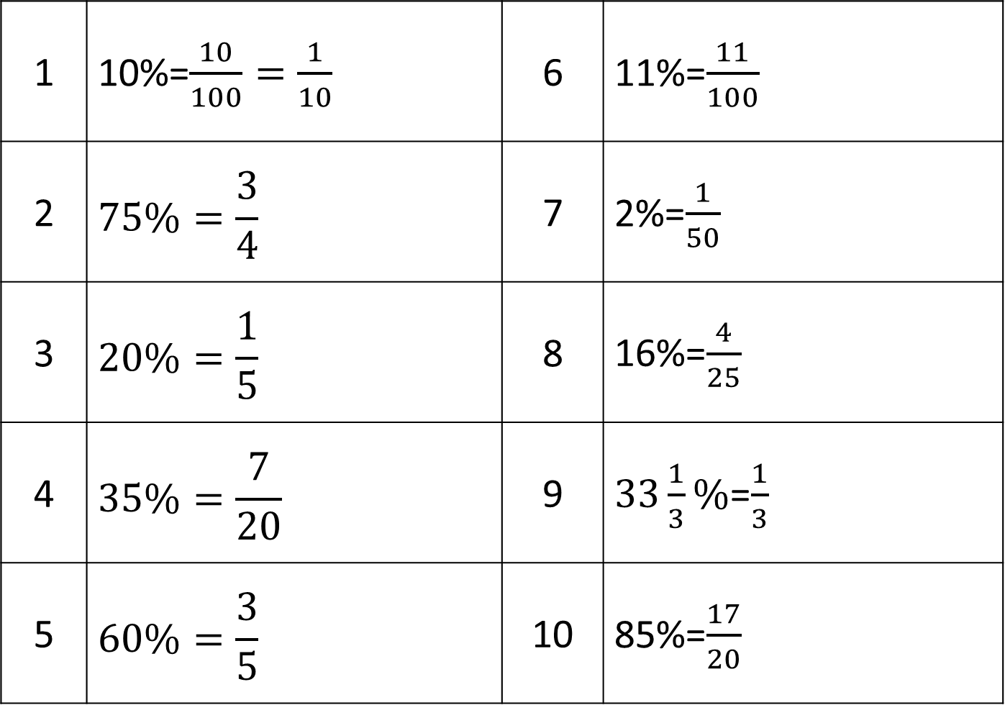
1 | 10%=$\frac{10}{100}=\frac{1}{10}$ | 6 | 11%=$\frac{11}{100}$
2 | $$75\%=\frac{3}{4}$$ | 7 | 2%=$\frac{1}{50}$
3 | $$20\%=\frac{1}{5}$$ | 8 | 16%=$\frac{4}{25}$
4 | $$35\%=\frac{7}{20}$$ | 9 | $33\frac{1}{3}\%$=$\frac{1}{3}$
5 | $$60\%=\frac{3}{5}$$ | 10 | 85%=$\frac{17}{20}$

Slide 5
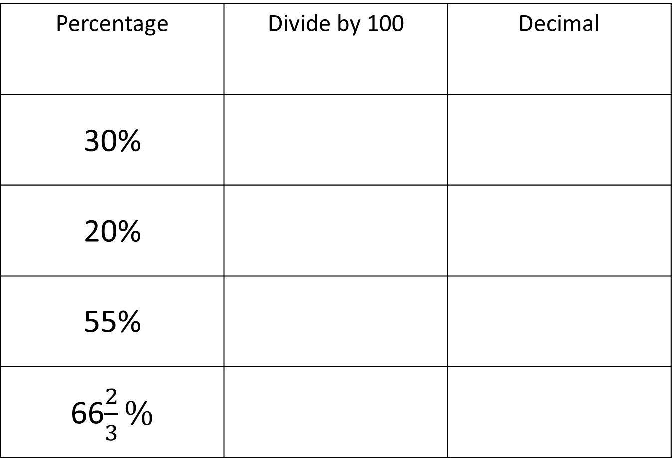
Converting percentages to fractions:
Percentage | Divide by 100 | Decimal
30%
20%
55%
66$\frac{2}{3}\%$

Slide 6
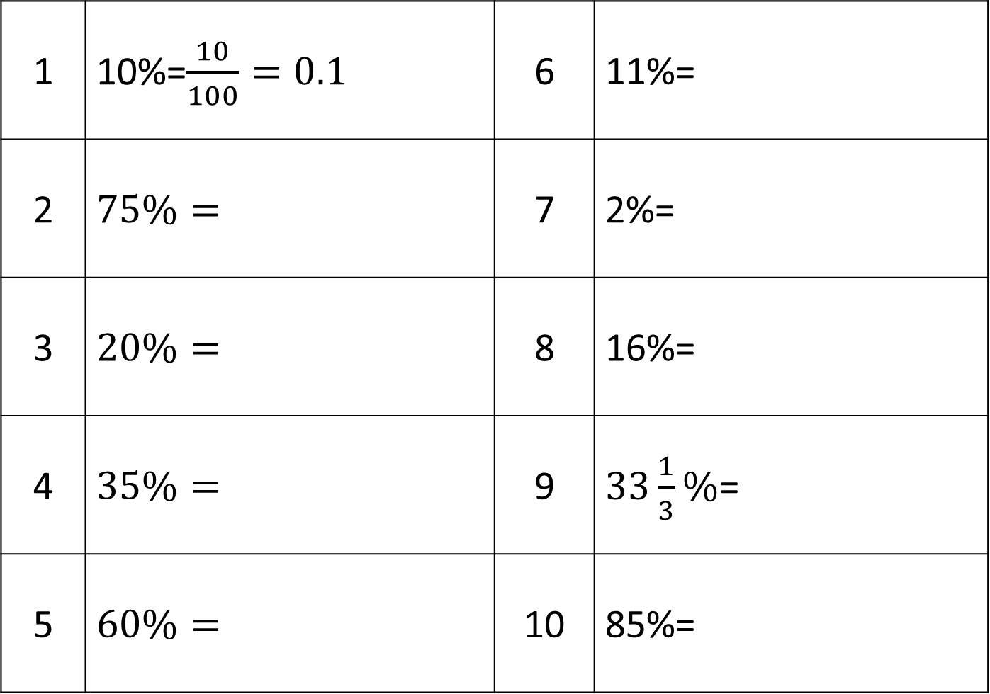
1 | 10%=$\frac{10}{100}=0.1$ | 6 | 11%=
2 | $$75\%=$$ | 7 | 2%=
3 | $$20\%=$$ | 8 | 16%=
4 | $$35\%=$$ | 9 | $33\frac{1}{3}\%$=
5 | $$60\%=$$ | 10 | 85%=
Convert to Decimals

Slide 7
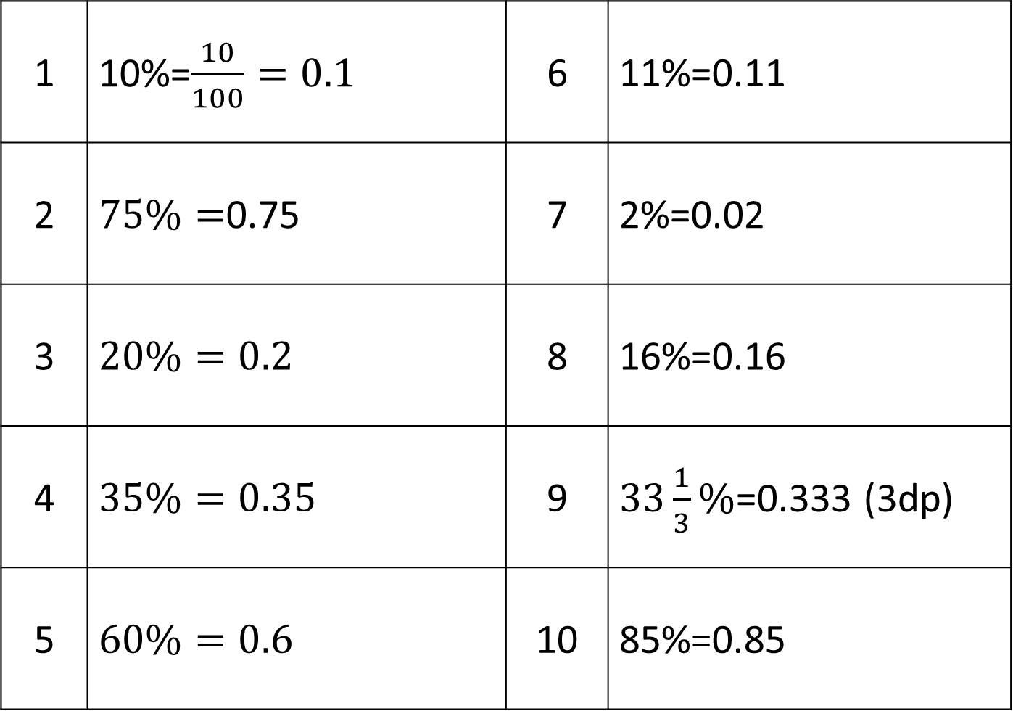
1 | 10%=$\frac{10}{100}=0.1$ | 6 | 11%=0.11
2 | $75\%=$0.75 | 7 | 2%=0.02
3 | $$20\%=0.2$$ | 8 | 16%=0.16
4 | $$35\%=0.35$$ | 9 | $33\frac{1}{3}\%$=0.333 (3dp)
5 | $$60\%=0.6$$ | 10 | 85%=0.85
Convert to Decimals

Slide 8
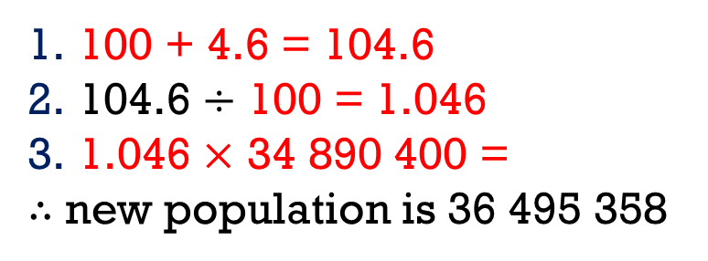
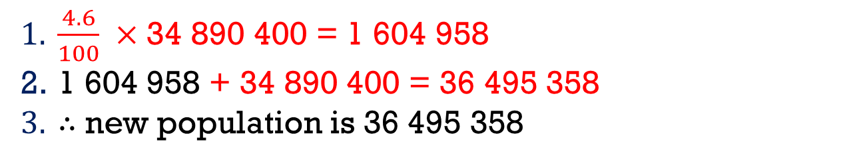
Increase / decrease by a percentage
Due to an open immigration policy a country managed to increase its population by 4.6%. If the original population was 34 890 400, determine the new population.
Steps:
Calculate percentage of amount.
Add /subtract to original amount depending increase or decrease
Answer question
Amateur-Increase
Expert - Increase
Add 100 to the % value
Divide by 100 (multiplier)
Multiply by original amount
Answer the question
$\frac{4.6}{100} ×$ 34 890 400 = 1 604 958
1 604 958 + 34 890 400 = 36 495 358
$∴$ new population is 36 495 358
100 + 4.6 = 104.6
104.6 $÷$ 100 = 1.046
1.046 $×$ 34 890 400 =
$∴$ new population is 36 495 358

Slide 9
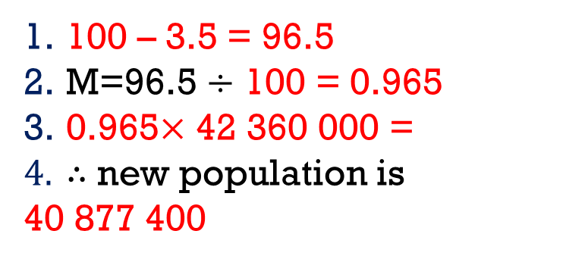
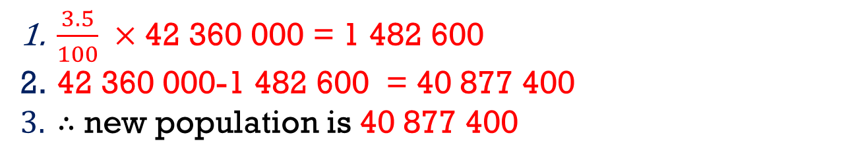
Increase / decrease by a percentage
Due to covid the population decreased by 3.5%. If the original population was 42,360,000 determine the new population.
Steps:
Calculate percentage of amount.
subtract from the original amount
Answer question
Expert - Decrease
100 take away the % value
Divide by 100 (multiplier)
Multiply by original amount
Answer the question
Amateur- Decrease
$\frac{3.5}{100} ×$ 42 360 000 = 1 482 600
42 360 000-1 482 600 = 40 877 400
$∴$ new population is 40 877 400
100 – 3.5 = 96.5
M=96.5 $÷$ 100 = 0.965
0.965$×$ 42 360 000 =
$∴$ new population is
40 877 400

Slide 10
Copy and complete the following table
Original | % Increase /decrease | Increase / Decrease amount | Final amount | What is the multiplier
45 | 8% inc
105 | 2.5% inc
16.6 | 3% dec
56 | 18% dec
80 | 200 % inc

Slide 11
Profit:
Definition: a financial gain, especially the difference between the amount earned and the amount spent in buying, operating, or producing something.
Percentage Increase or Decrease
Loss:
Definition: amount that has been taken away or cannot be recovered.
Percentage Increase or Decrease

Slide 12
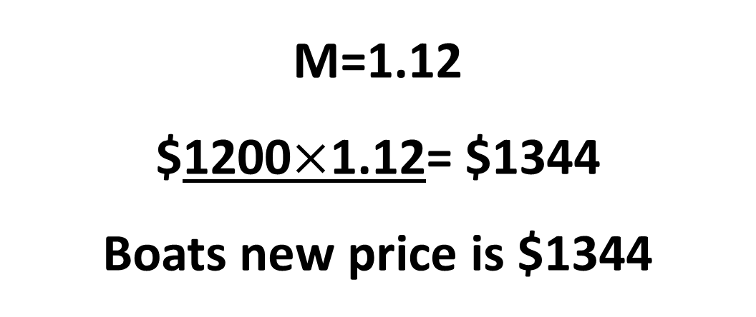
Expert - Increase
Add 100 to the % value
Divide by 100 (multiplier)
Multiply by original amount
Answer the question
A boat’s price was increased from $1200 by 12%. What is its new price?
What is its new price?
M=1.12
$1200$×$1.12= $1344
Boats new price is $1344

Slide 13
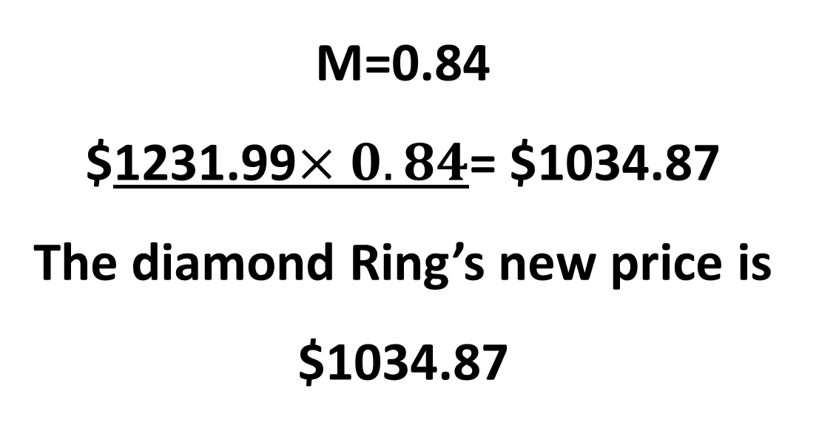
Expert - Decrease
100 take away the % value
Divide by 100 (multiplier)
Multiply by original amount
Answer the question
What is its new price?
M=0.84
$1231.99$×0.84$= $1034.87
The diamond Ring’s new price is $1034.87

Slide 14
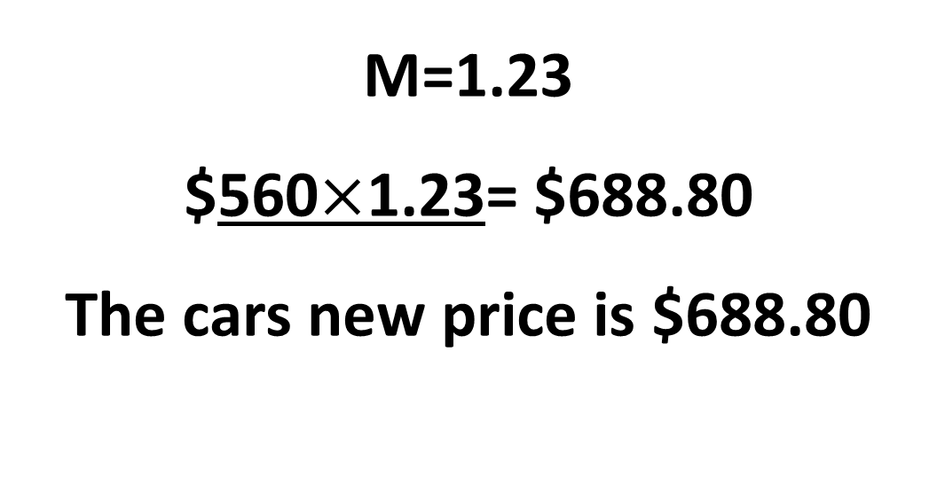
Expert - Increase
Add 100 to the % value
Divide by 100 (multiplier)
Multiply by original amount
Answer the question
A car bought for $560 was sold to receive a 23% profit.
What is its new price?
M=1.23
$560$×$1.23= $688.80
The cars new price is $688.80

Slide 15
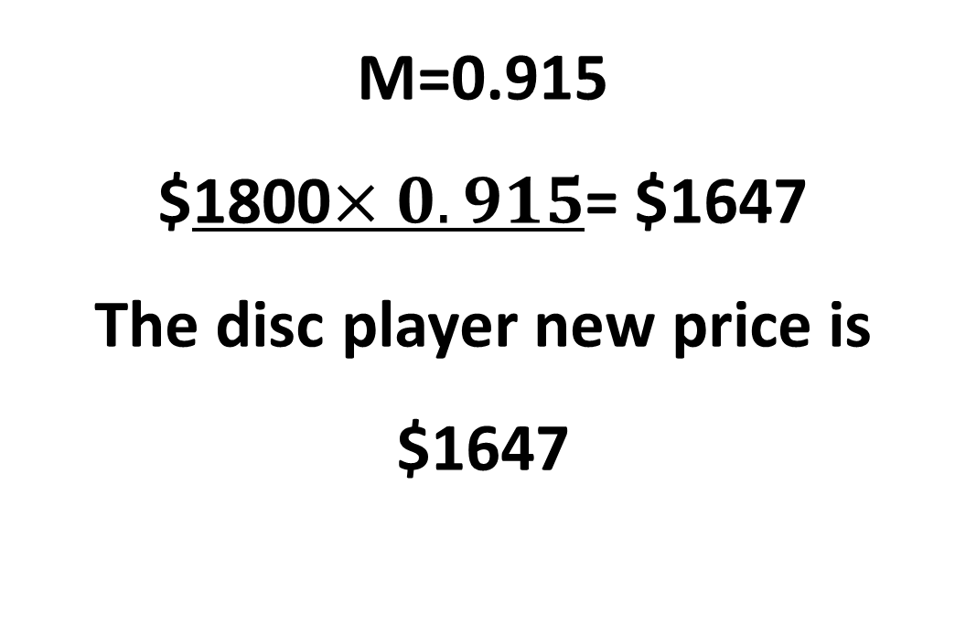
Expert - Decrease
100 take away the % value
Divide by 100 (multiplier)
Multiply by original amount
Answer the question
What is its new price?
M=0.915
$1800$×0.915$= $1647
The disc player new price is $1647

Slide 16
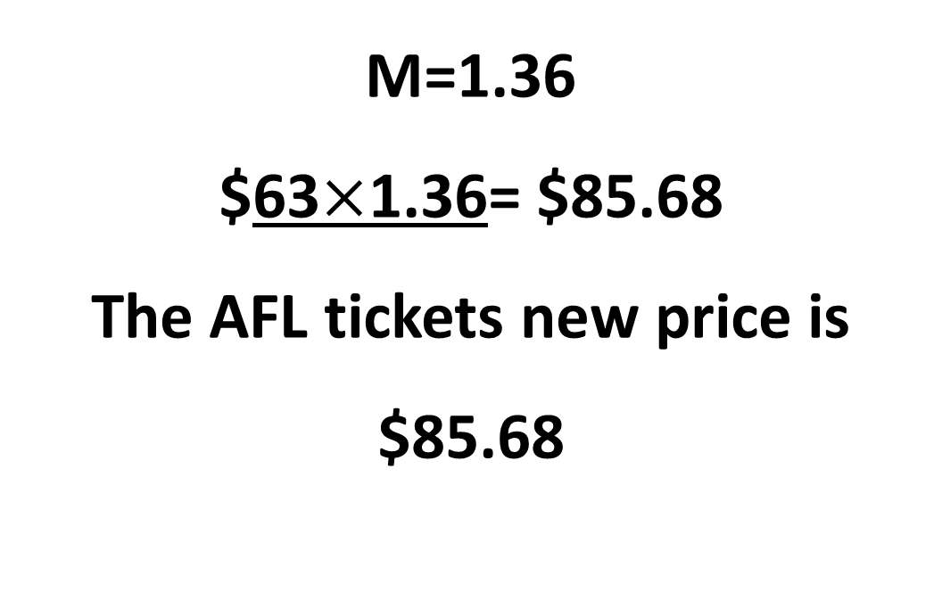
Expert - Increase
Add 100 to the % value
Divide by 100 (multiplier)
Multiply by original amount
Answer the question
Rob sold his $63 AFL ticket for a 36% profit.
What is its new price?
M=1.36
$63$×$1.36= $85.68
The AFL tickets new price is $85.68

